Slide 1
ADBI Final Capstone Project
Team:
Vishnu Ramachandran (vcramach)
Sharique Khan (mkhan8)
Natansh Negi (nnegi2)
Unstructured Text to Knowledge Graphs using NLP tools

Slide 2
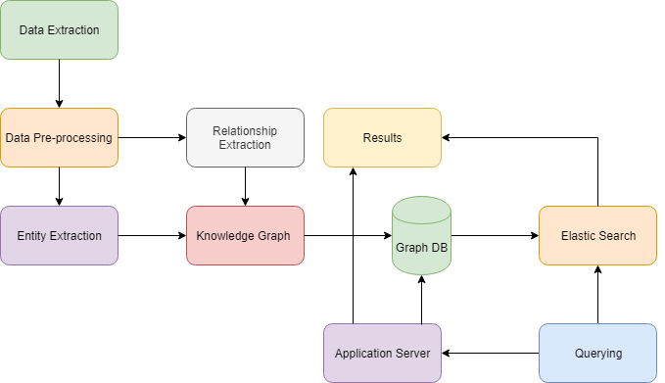
Flow Chart

Slide 3
Data Extraction
Extracted Movie database from Wikipedia.
Dataset: Summary/Synopsis for 9000 movies.
Tool used for extraction : Scrapy

Slide 4

Data Preprocessing
Using Python’s nltk package did the following:
Eliminated stop words.
Tokenization & Stemming.
Case, negation and punctuation handling.
Transformation(removed unnecessary attributes).

Slide 5
Entity Extraction
Tasks of Named Entity Extraction:
Extract Names.
Classify the extracted names.
Tool Used: Spacy

Slide 6
Relation Extraction
Returns the relations between two entities.
Designed an algorithm to extract the relations between entities returned by Spacy using POS tagging.
Eg: Jumanji directed Joe Johnston
Entity
Entity
Relation

Slide 7
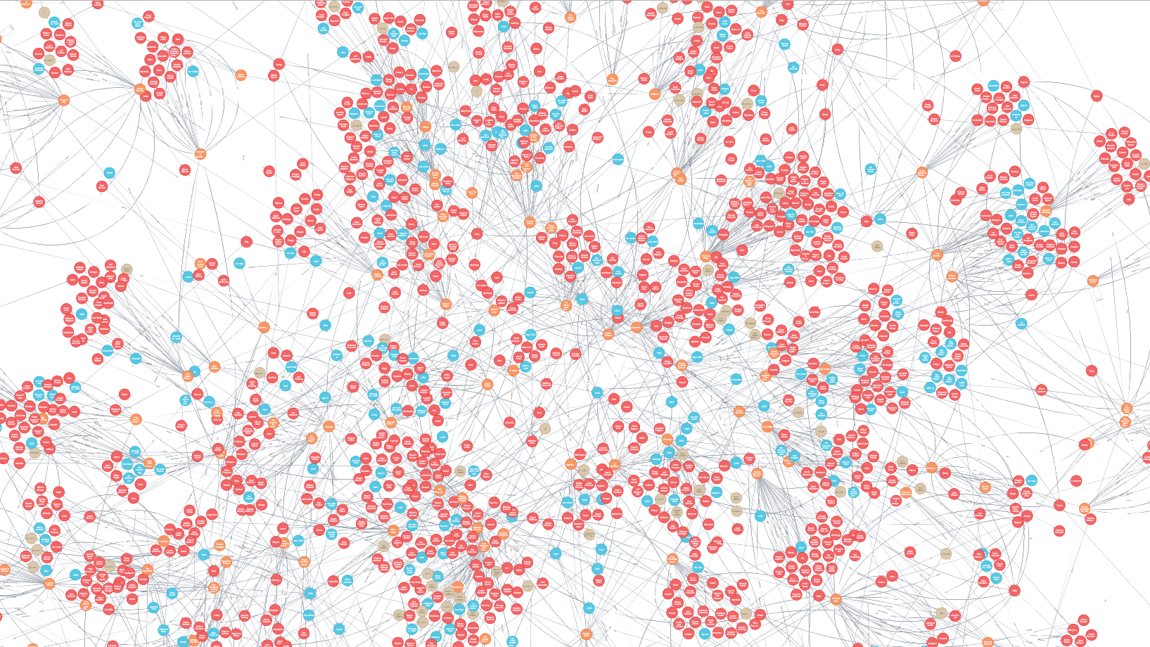
Knowledge Graph
A knowledge graph acquires and integrates information into an ontology and applies a reasoner to derive new knowledge.
Snippet of our Knowledge Graph(background)

Slide 8
Query
Querying our knowledge Graph using Google’s Elasticsearch.
Parameters available for querying :
Movie
Date
Person

Slide 9
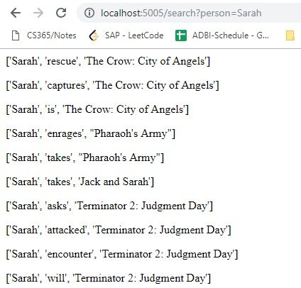
Results
We query on the knowledge graph using the Person ‘Sarah.’
This returns the entity relationships and extended attribute relations deduced from random walks through the knowledge graph.

Slide 10
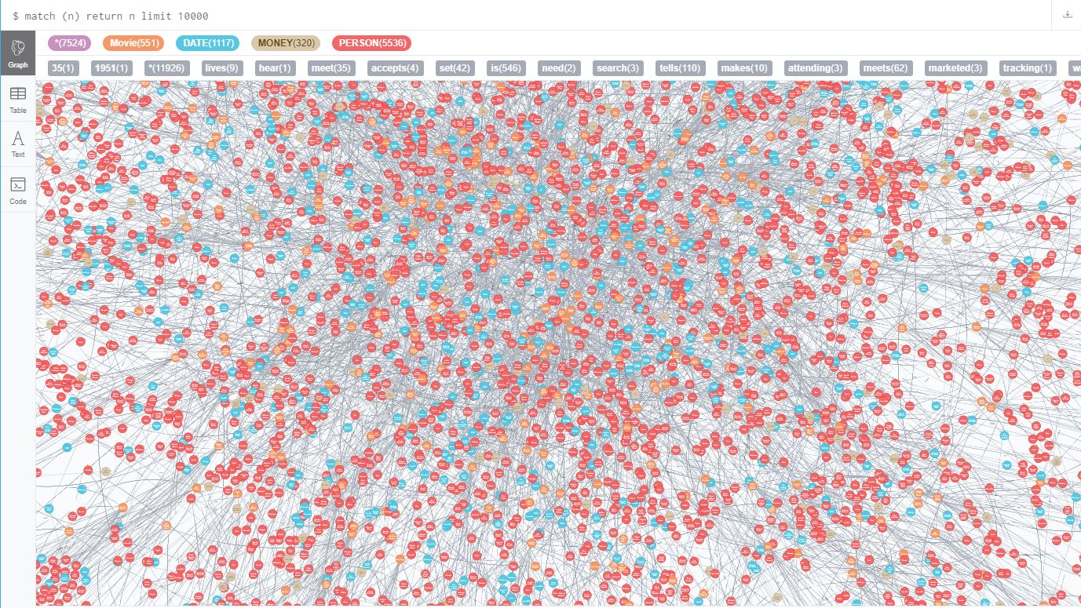
Thank You

